Slide 1

Photography and Photographers Management System
Supervised by
Submitted by
Mohammed Morshed Rana
Lecturer,
Department of CSE
Morshedul Islam
ID: CSE 01706594
Batch: 17th (Day)

Slide 2
TABLE OF CONTENT
Introduction
Motivation
Objective
System Architecture
ER Diagram
Requirements
Implementation
Conclusion

Slide 3
INTRODUCTION
Photography is the art, application, and practice of creating durable images by recording light. Within the visual arts, photography can be categorized as either fine art or commercial art.
A wonderful way for photographers to get extra money is by selling their images online. In the photography industry, there are more methods to make money than merely taking pictures. He may even be hired for his service.

Slide 4
MOTIVATION
Anyone may purchase and sell photographs using this method by following a few simple, understandable procedures.
We can enhance the photographer's attraction on photography by organizing photo contests.
Photographers may be hired based on their hierarchical divisions.

Slide 5
OBJECTIVE
To provide a means of compensation for the photographer's skill.
To guarantee that buyers looking for the top photographs may obtain the best.
To encourage the photographers by holding photo contests in various categories depending on their skills.

Slide 6
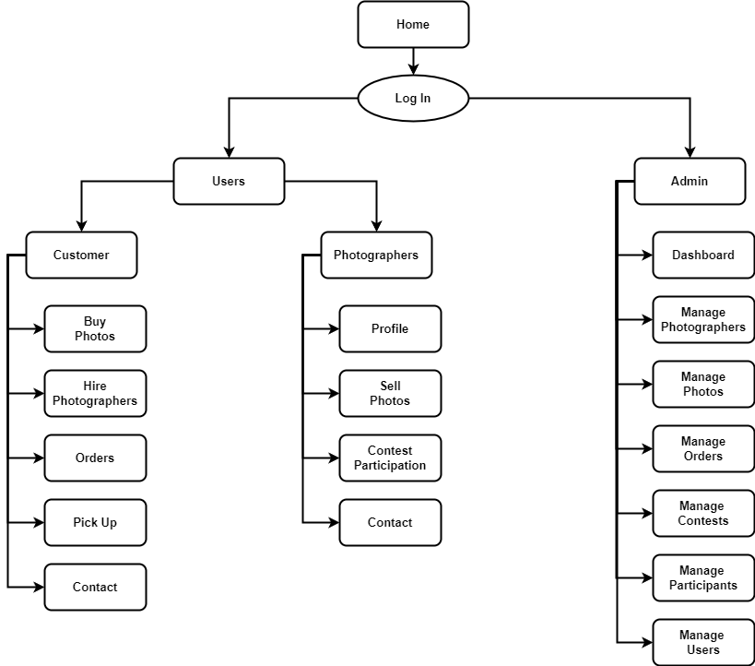
SYSTEM ARCHITECTURE
Figure: System Architecture

Slide 7
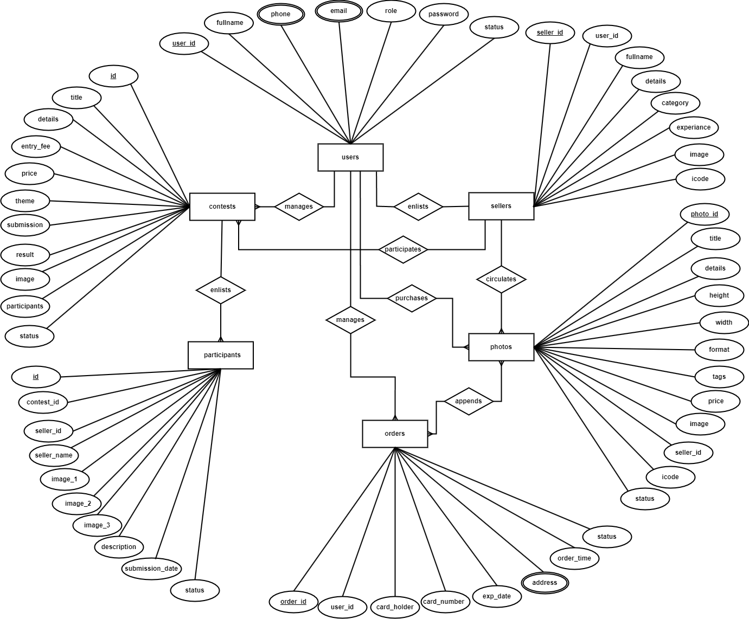
ER DIAGRAM
Figure: ER Diagram

Slide 8
REQUIREMENTS
System
Software
Language
Windows, Linux or MacOS
Xampp Server, Web Browser, VS Code
HTML, CSS, Bootstrap, Javascript, Jquery, PHP, MySql

Slide 9

IMPLEMENTATION
Log In

Slide 10

IMPLEMENTATION
Sign Up

Slide 11
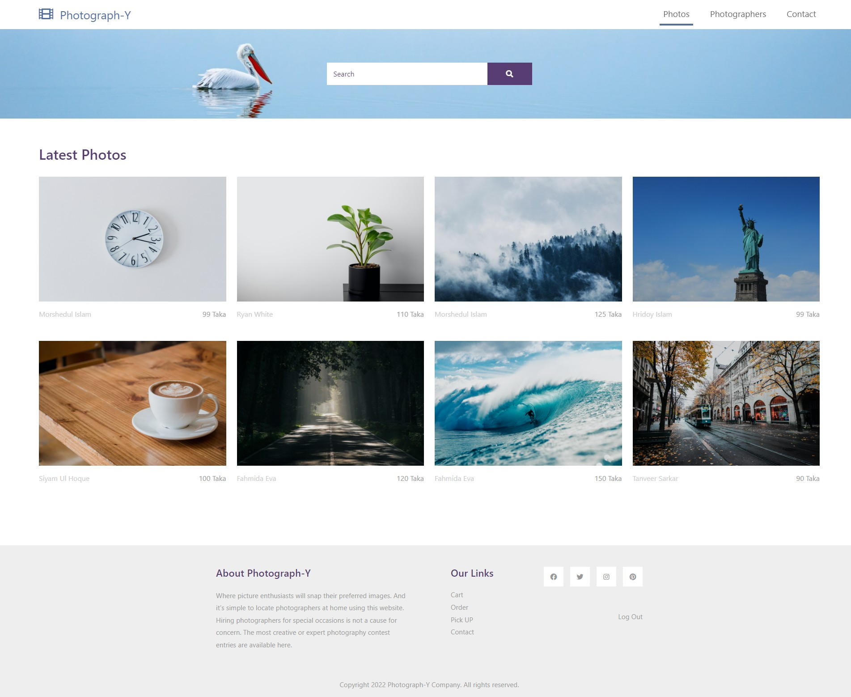
IMPLEMENTATION
Photos

Slide 12
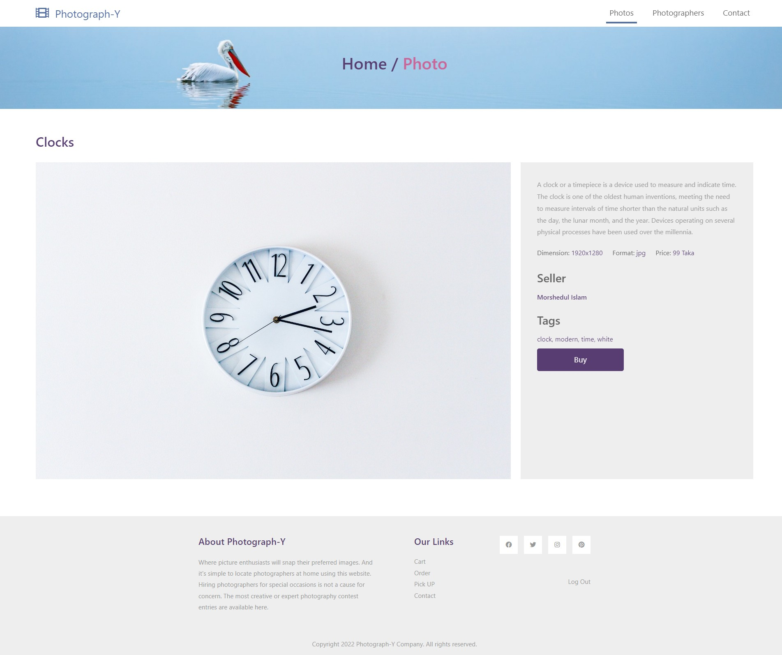
IMPLEMENTATION
Photo Details

Slide 13
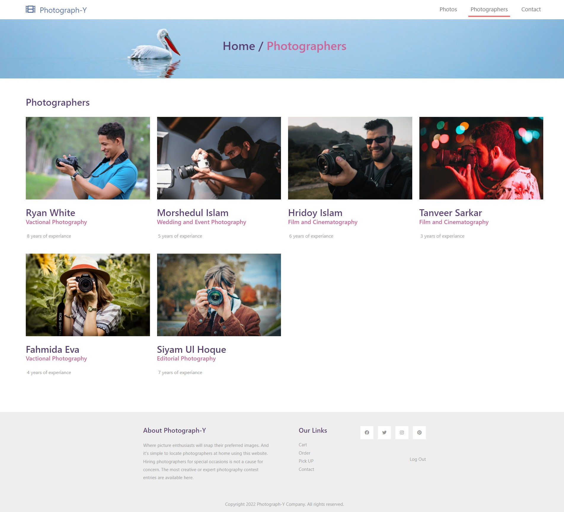
IMPLEMENTATION
Photographers

Slide 14
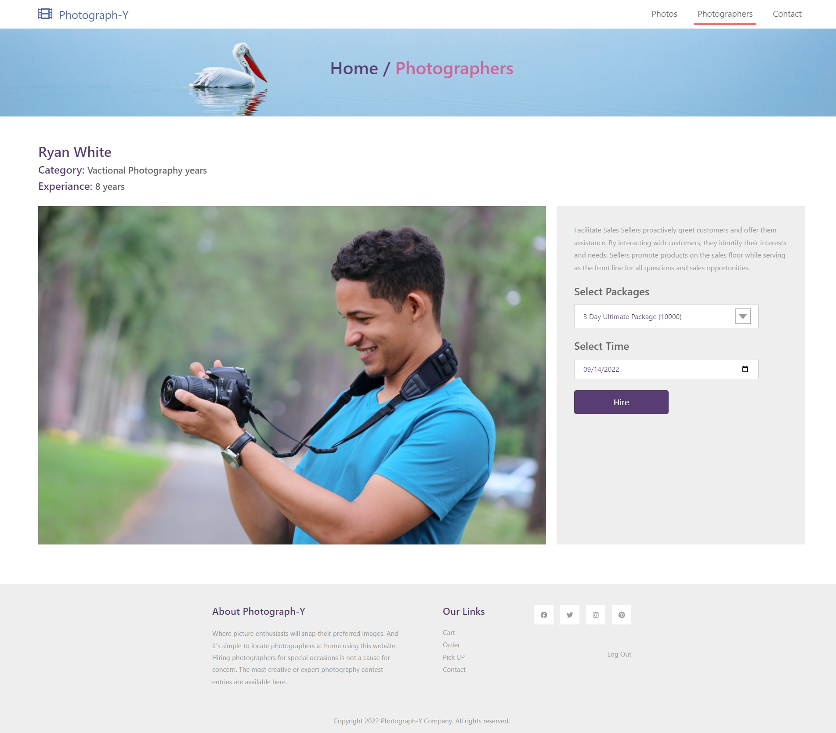
IMPLEMENTATION
Photographer
Details

Slide 15
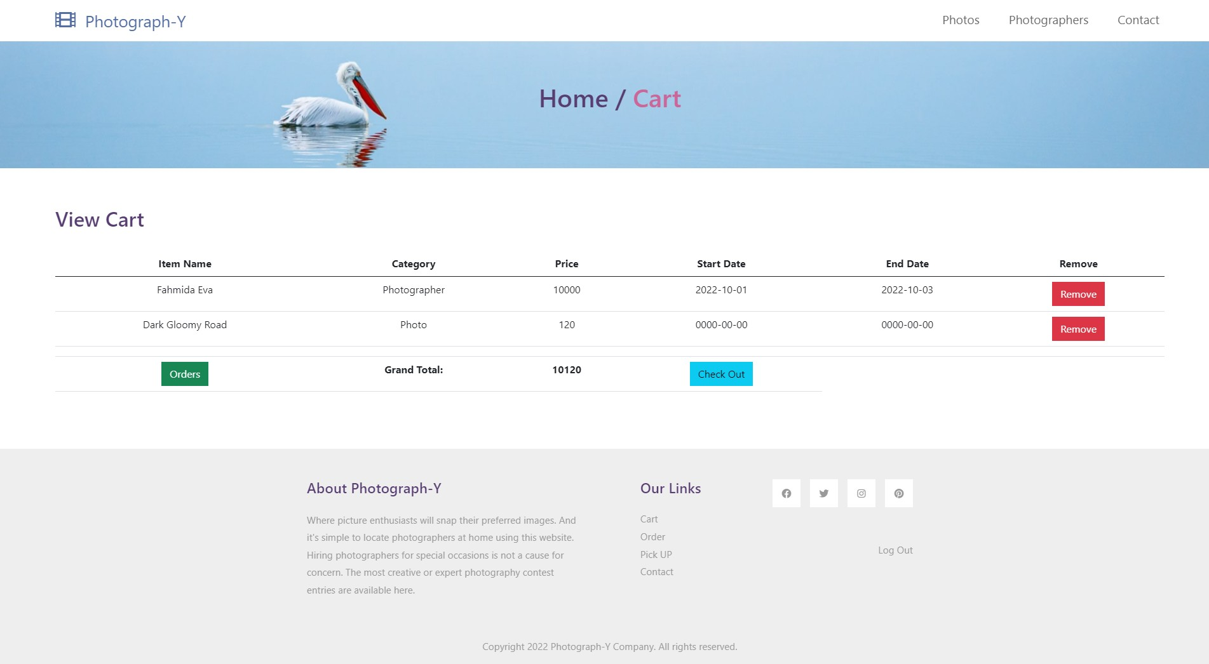
IMPLEMENTATION
Cart

Slide 16
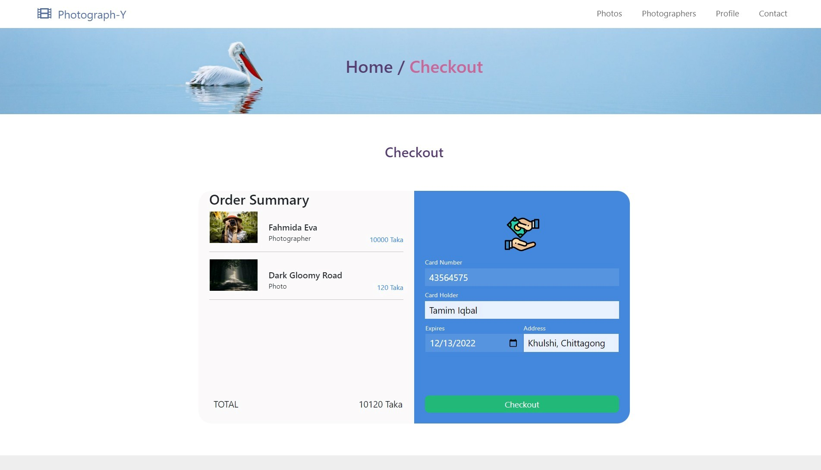
IMPLEMENTATION
Checkout

Slide 17
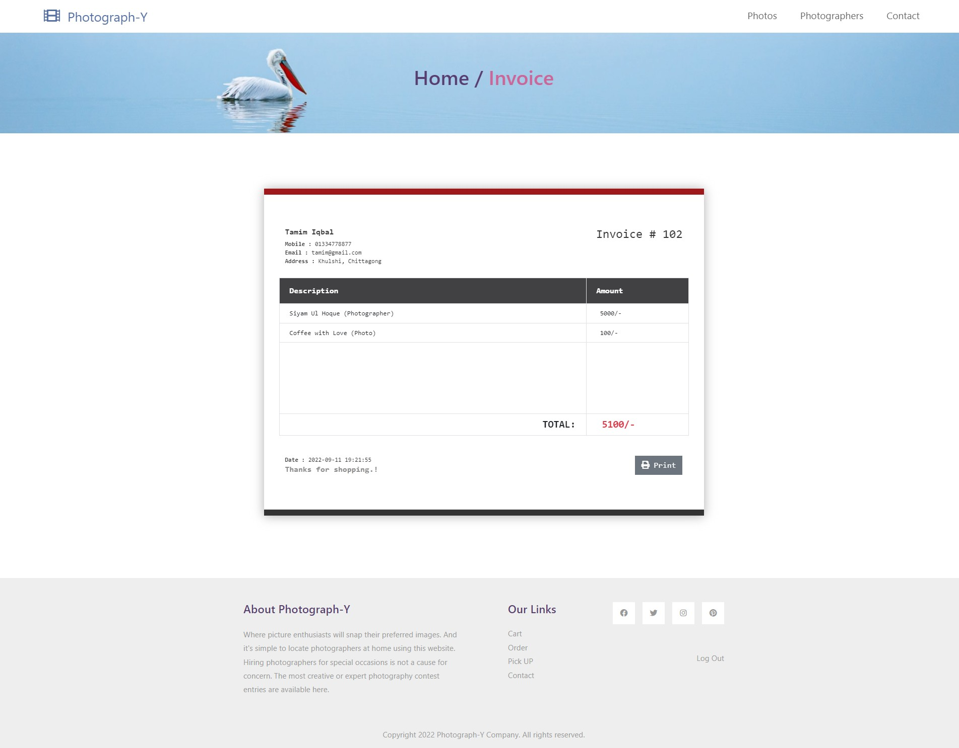
IMPLEMENTATION
Invoice

Slide 18
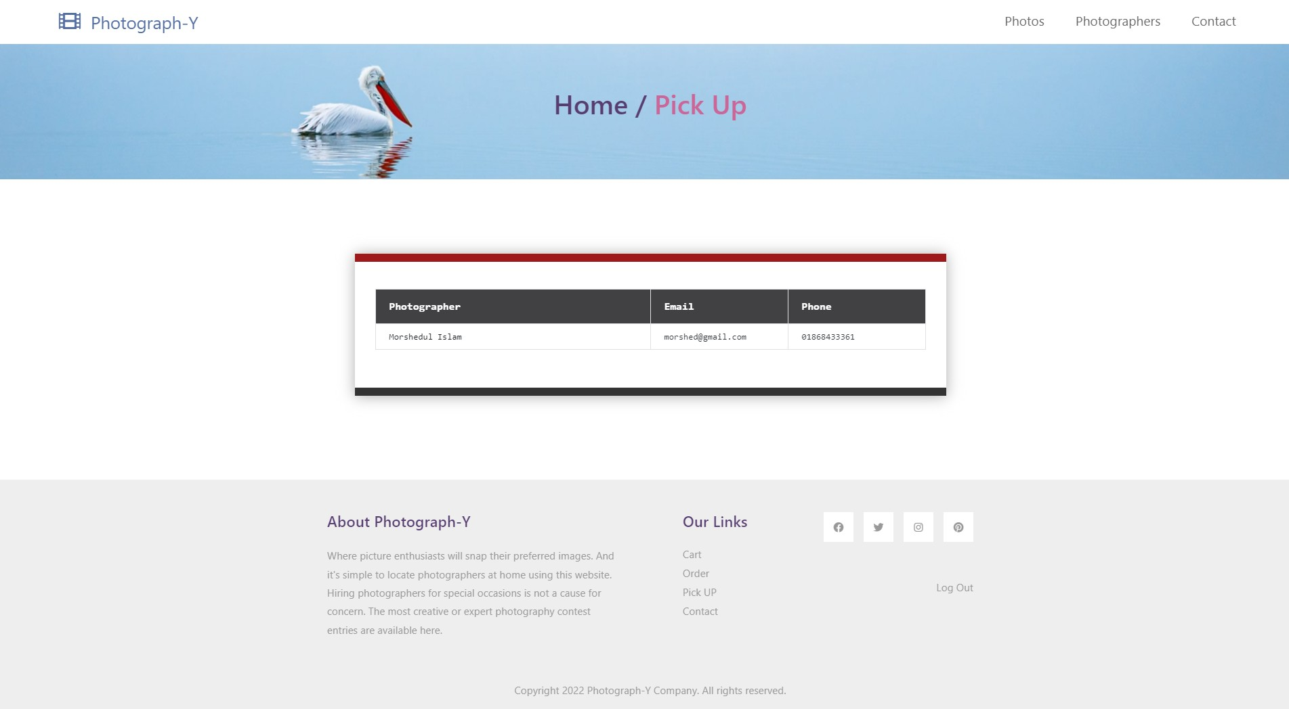
IMPLEMENTATION
Pick UP

Slide 19
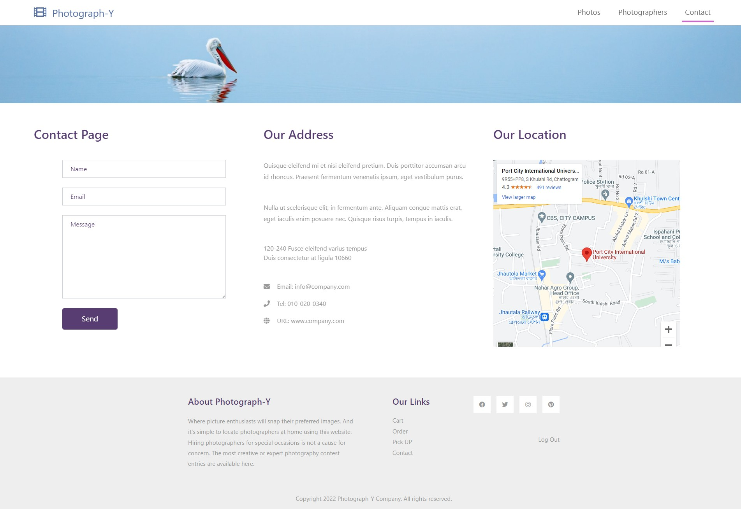
IMPLEMENTATION
Contact

Slide 20
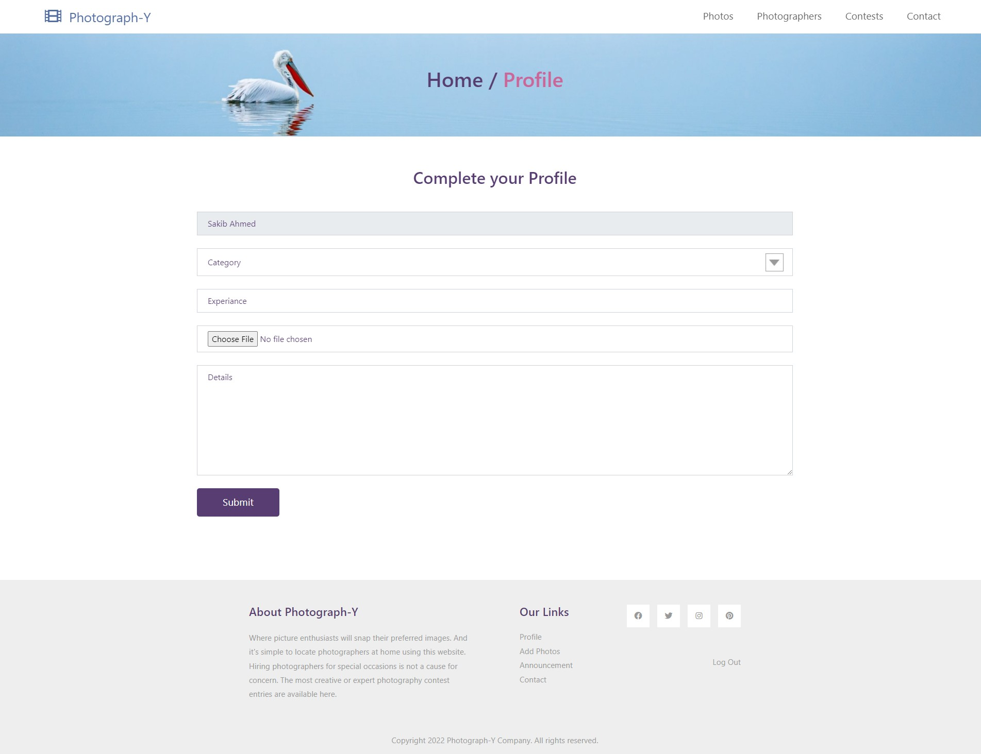
IMPLEMENTATION
Photographer
Profile

Slide 21
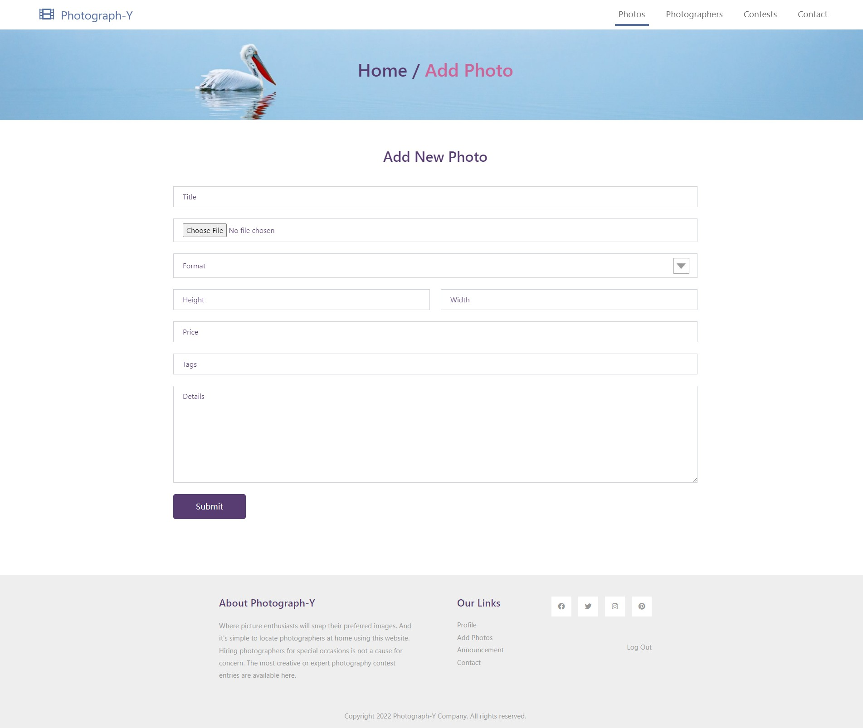
IMPLEMENTATION
Add Photo

Slide 22
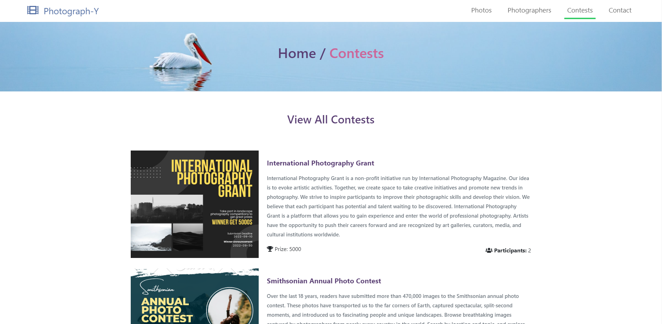
IMPLEMENTATION
Contests

Slide 23
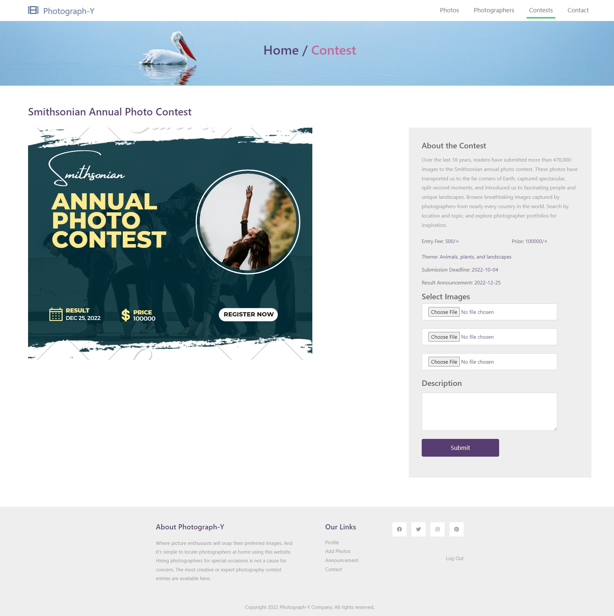
IMPLEMENTATION
Participation

Slide 24

IMPLEMENTATION
Contact

Slide 25
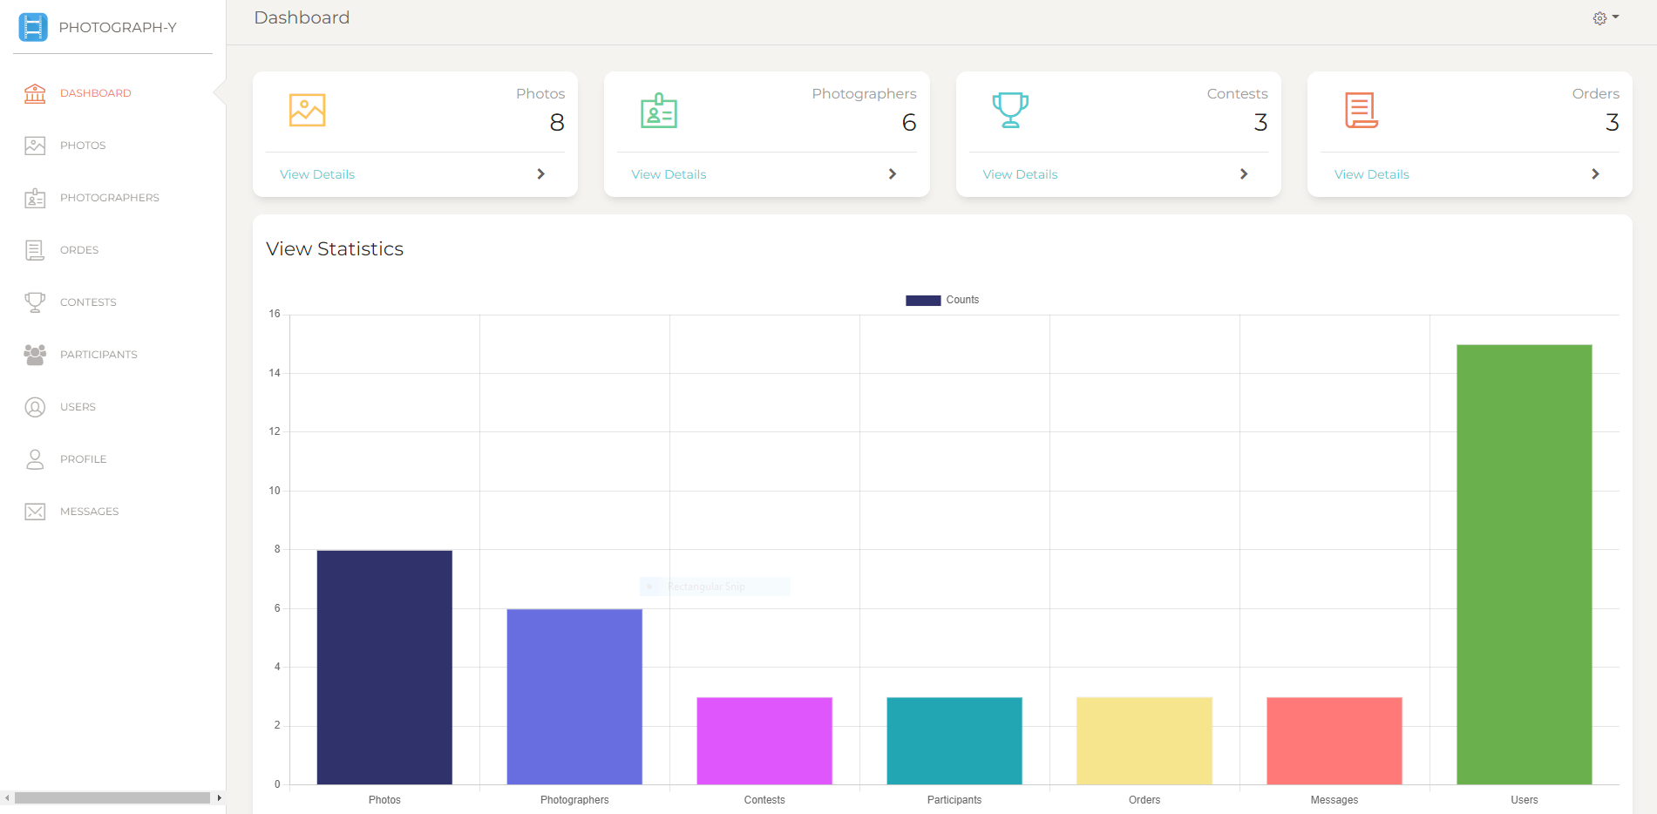
IMPLEMENTATION
Dashboard

Slide 26
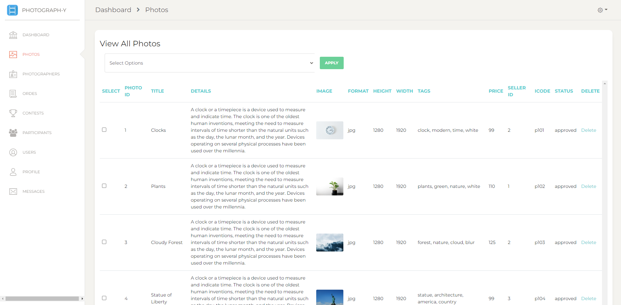
IMPLEMENTATION
Photos

Slide 27
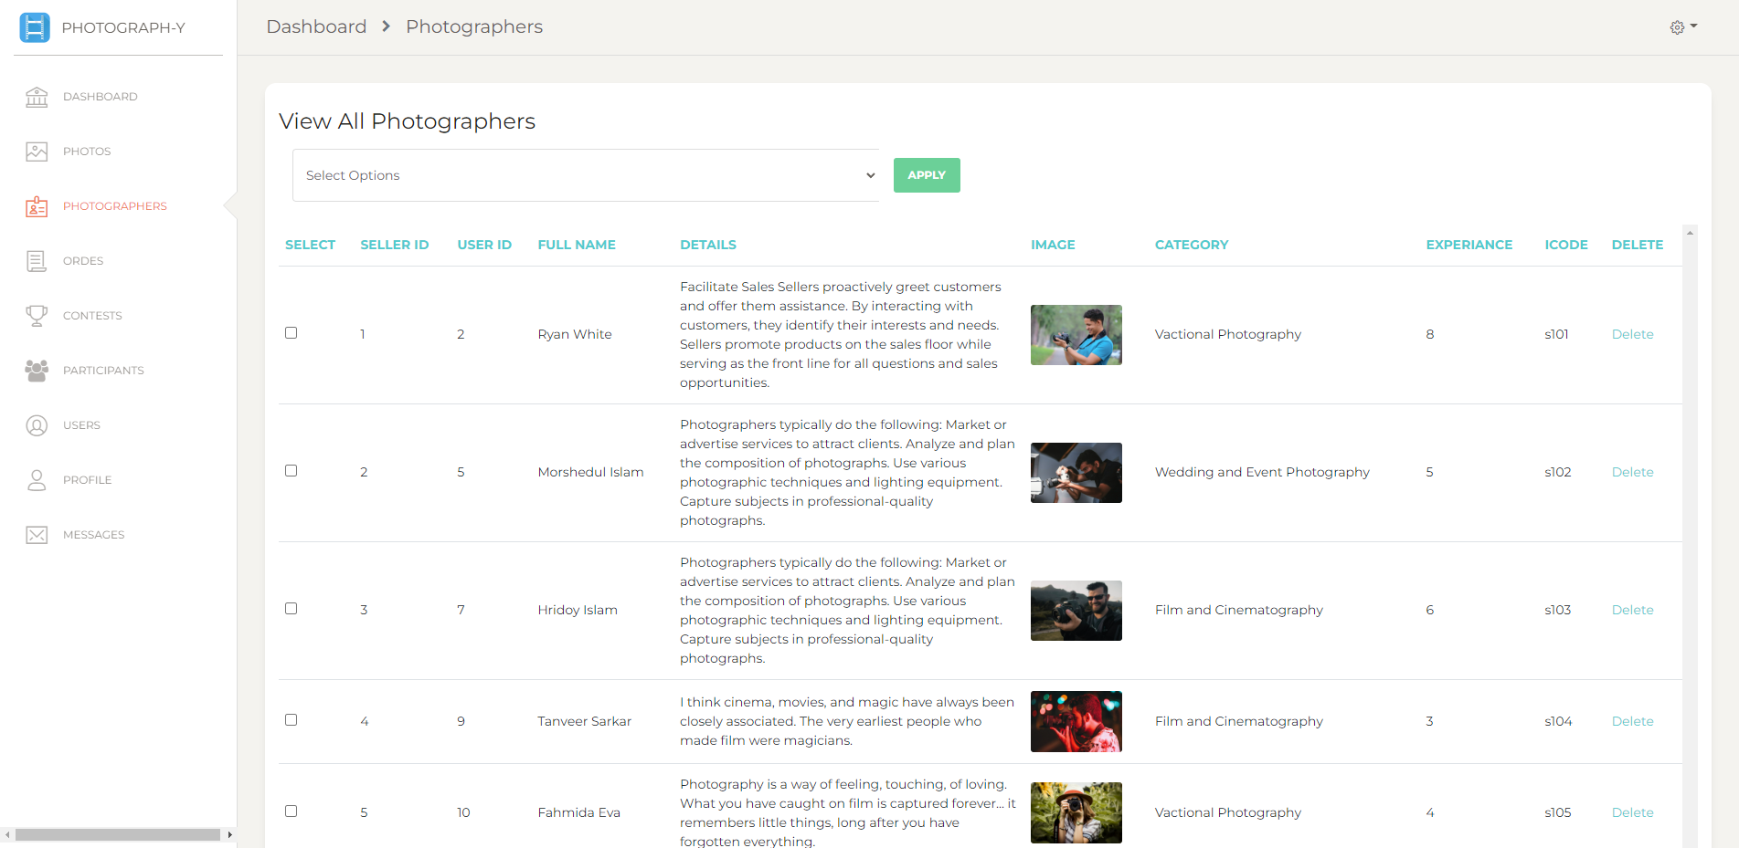
IMPLEMENTATION
Photographers

Slide 28
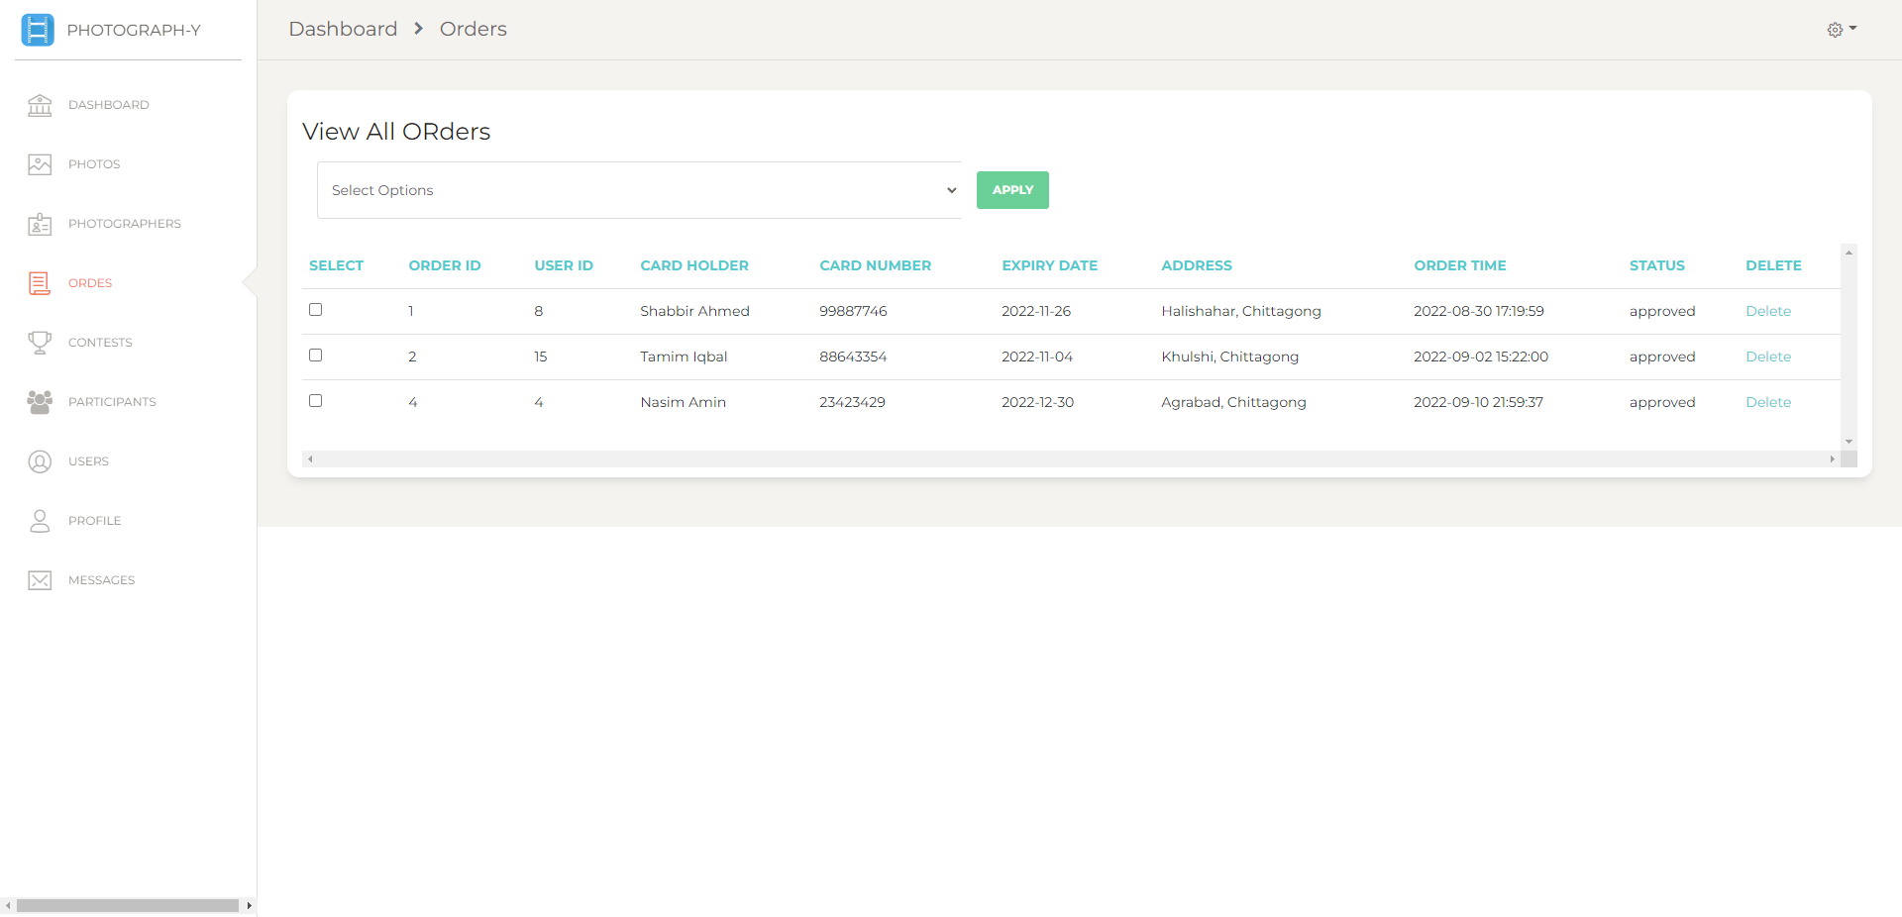
IMPLEMENTATION
Orders

Slide 29
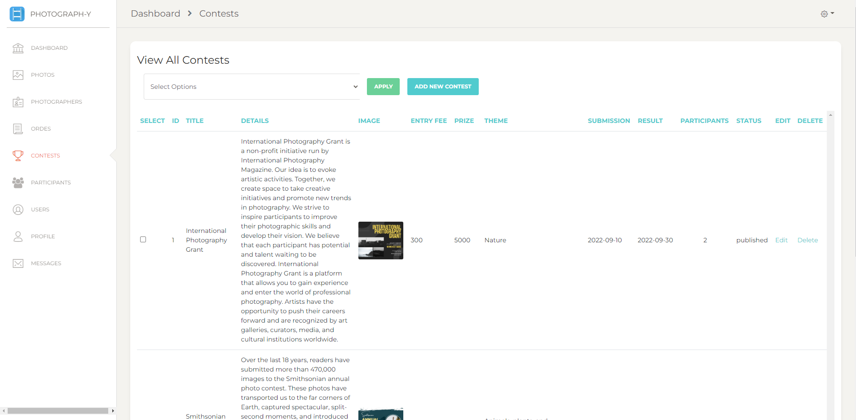
IMPLEMENTATION
View All Contests

Slide 30
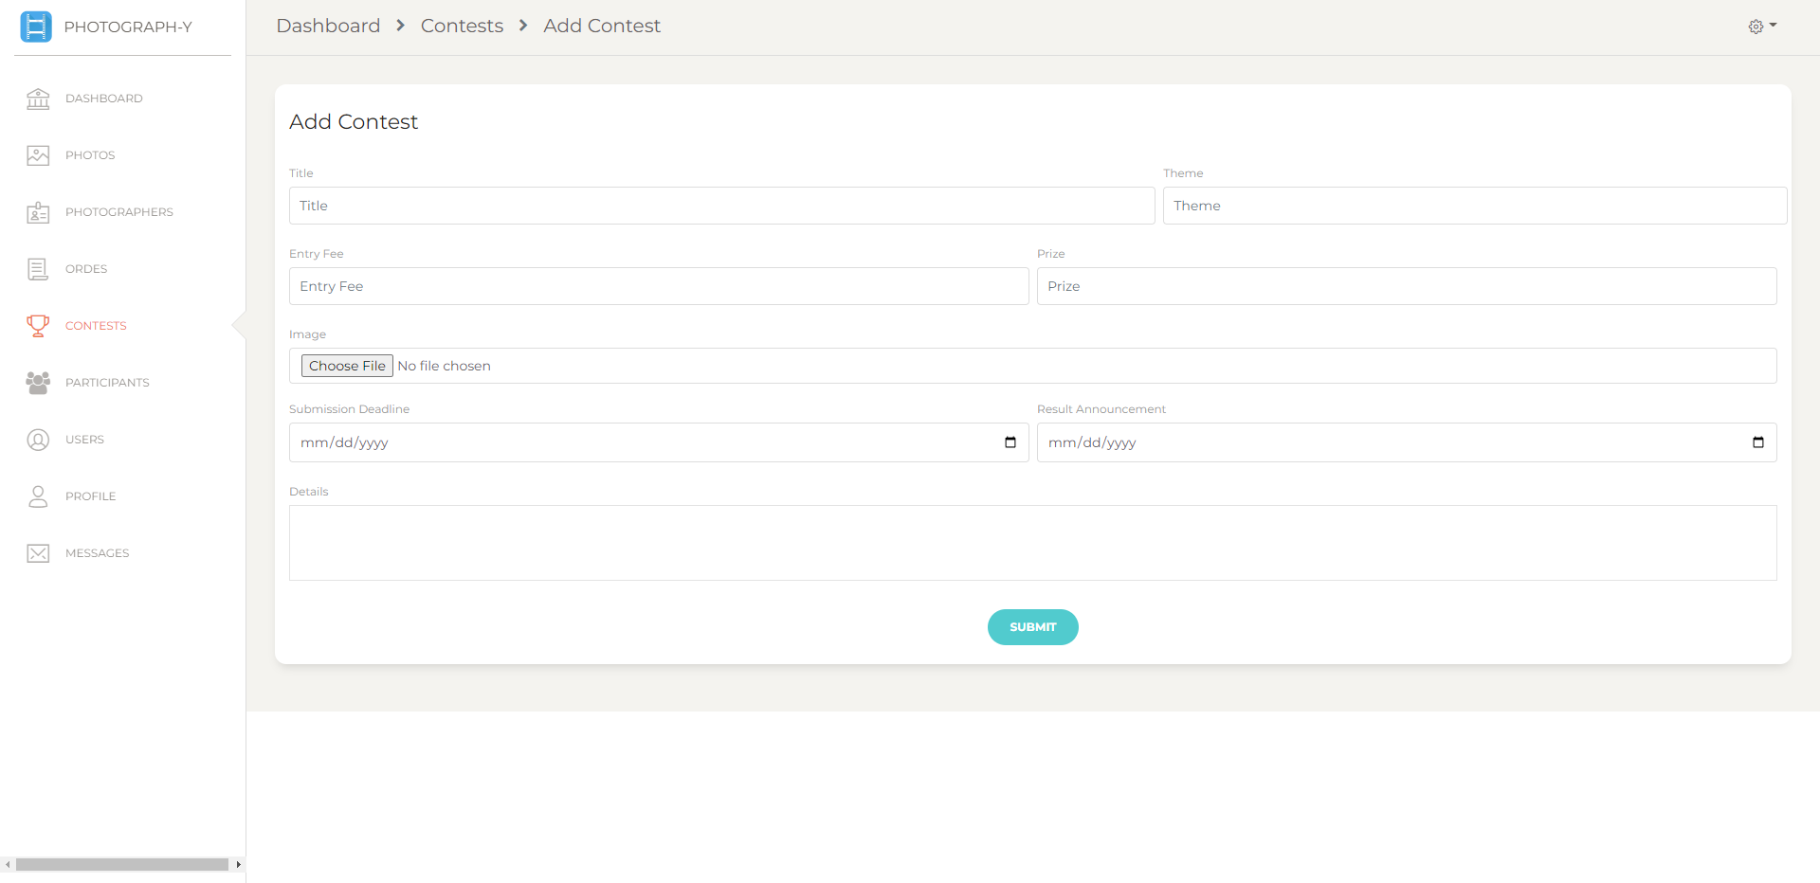
IMPLEMENTATION
Add Contest

Slide 31
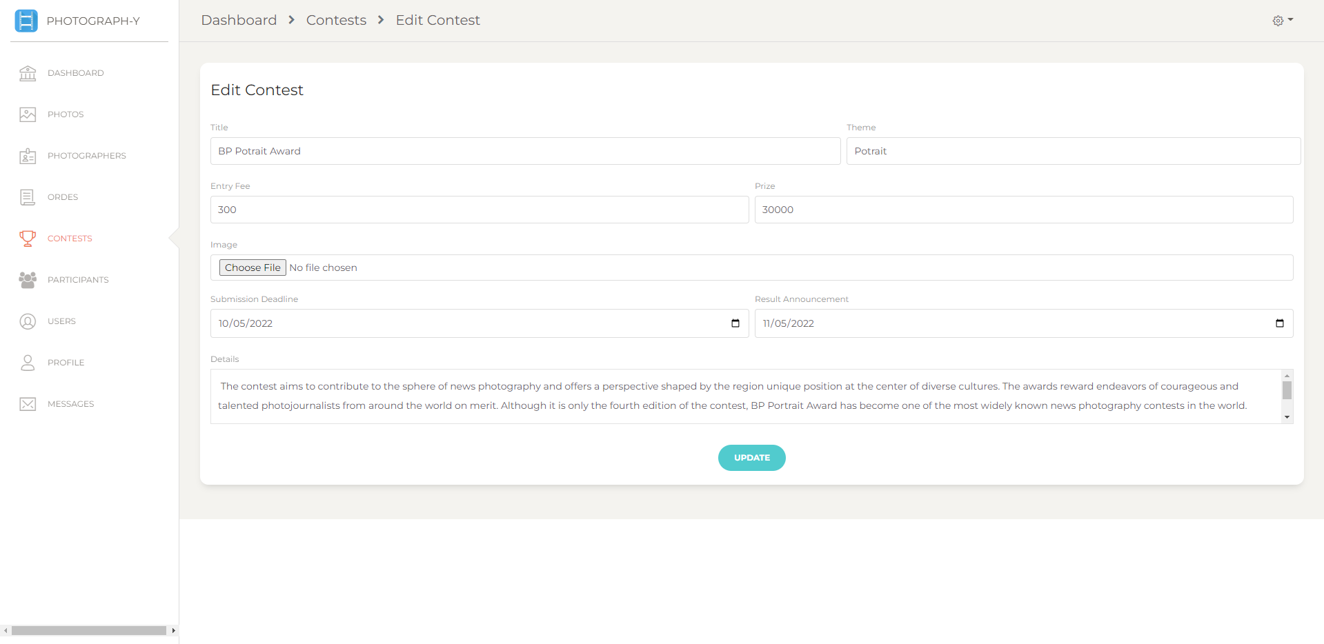
IMPLEMENTATION
Edit Contest

Slide 32
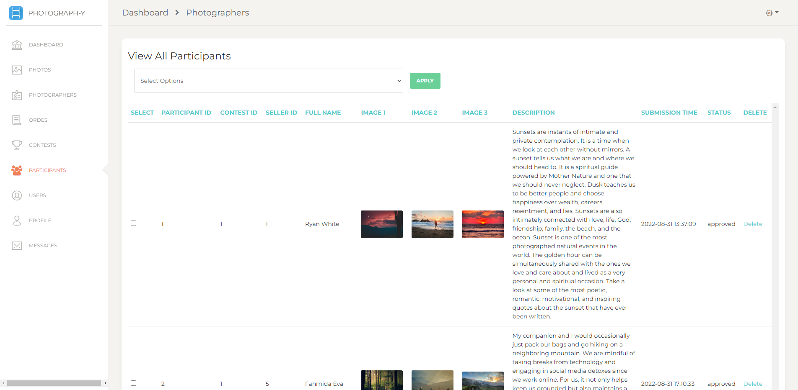
IMPLEMENTATION
Participants

Slide 33
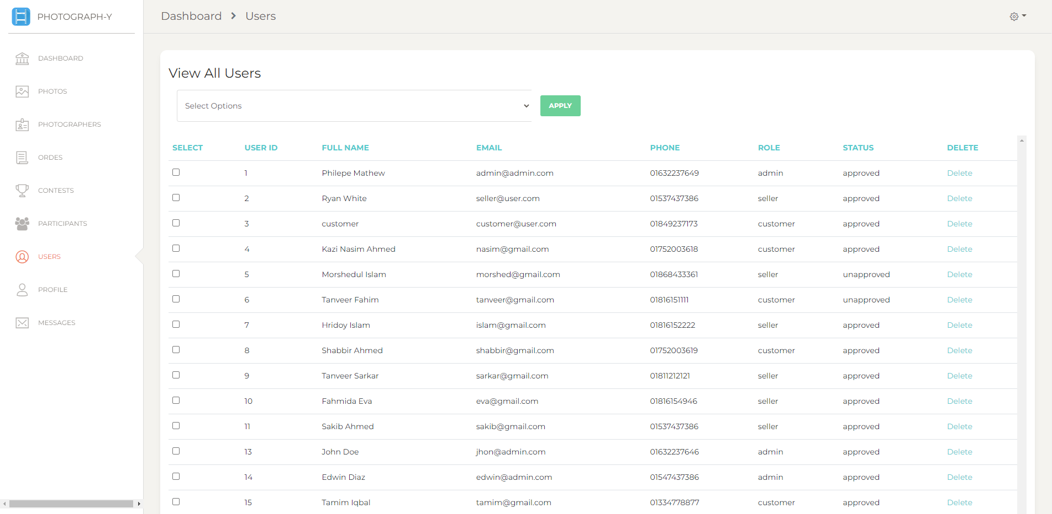
IMPLEMENTATION
Users

Slide 34
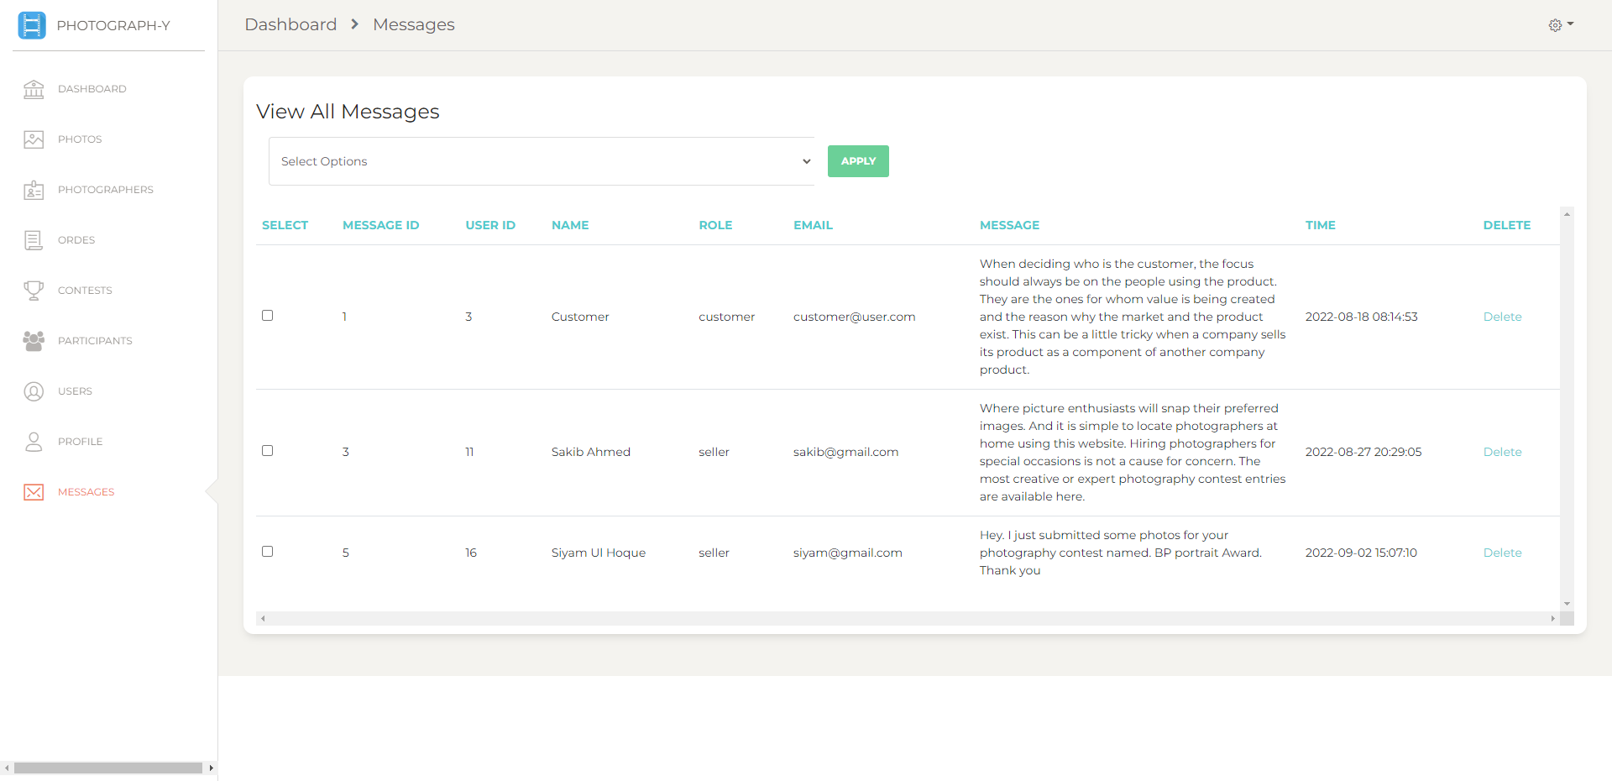
IMPLEMENTATION
Messages

Slide 35
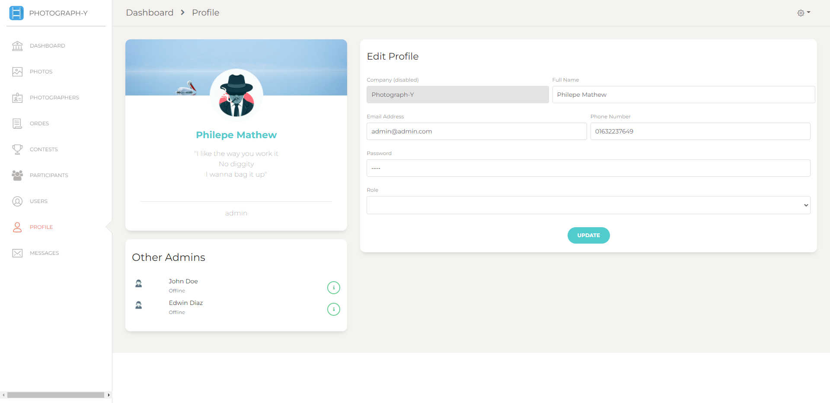
IMPLEMENTATION
Profile

Slide 36
CONCLUSION
Creating an user friendly system can help everyone to get an easy to access it.
Test the system by random users and take feedback from them can be useful for further upgrade and changes.

Slide 37
FUTURE WORK
The system can be hosted in web server and use it in any photo and photographers management system company as their online startup.
With the assistance of this system, several sponsors may launch contests for further marketing and promotion to discover the abilities of upcoming photographers.

Slide 38
THANK YOU
Do you have any questions?

